Slide 1

CIVIL CONSTRUCTION WORK

Slide 2


Business Overview
Partnering End to End Services
Cosmo Infrasolutions is a leader in providing integrated support from service to solutions. It has been serving various industries pertaining to infrastructure for over two decades.
COSMO has successfully executed various civil works for all kind of Industries. As Total Service Provider (TSP), we undertake & do complete execution of Commercial buildings, Radio-genomics lab, Industrial units, Petrol pumps, Windmill, Solar power plant, Telecom sites & Data Centres.

Slide 3
Company’s Milestones
Proud recipient of “Best Service provider” by Indus Towers Ltd.
An ISO 9001, ISO 14001 & ISO 45001 certified Company.
Awarded Best Professionally Managed Company by CIDC (A Government of India Enterprise).
Delivered India`s first “Ground Based Satellite Access Portal” site at Mehsana
Upgradation and Development of 31+ DC sites for various customers like Airtel, Nxtra ,Indus etc.
PAN India Footprint with Highly skilled professionals with Specialized Teams.

Slide 4

Our Services
Pre-construction services
Construction services
Project Management services
Renovation & Restoration services

Slide 5




Our Services
Pre- Construction Services
Project Scope
Project Cost
Project Feasibility
Necessary Permits
Plan
preliminary construction budget.
Prepare initial
bid on estimation.
Construct final
bid post design.
Determine
project feasibility.
Do necessary
amendments if
not feasible.
Determine
Project scope.
Prepare
strategic development plan.
This process involves
acquiring necessary
permissions and
clearances from local,
regional, and sometimes
national regulatory
bodies.

Slide 6







Our Services
Construction Services
Land Development
Resources Management
Civil-Infra work
Precast Boundary wall
Road & Drainage work
Mechanical, Electrical & Plumbing work
Interior & Exterior work

Slide 7

Our Services
Project Management Services
Overseeing the entire construction process to ensure that the project is completed effectively, efficiently and timely.
Renovation & Restoration Services
Updating and repairing existing infrastructures.

Slide 8




Our Health and Safety Policy
Permits to work
Workplace Supervision
Specific authorization to commence work post
assessment and mitigation of Risk / Safety Threat.
100% supervisor at site With respect to
Quality, Safety management,
work Progress and site management.
Personal Protective Equipment
EHS Awareness Programs
Used as per job specification and
requirements to ensure protection from any
personal injuries to the site team.
Organised parodically as National Safety
Week, Fire Safety Week , World
Environmental Day etc. to create awareness
in the employees.
Safety Trainings & Skill Development
Program to be conduct according to TNI
(Training Need Identifications) and task specific .

Slide 9







Our Mission, Vision & Values
Mission : To provide our customers construction solutions using our expertise in the design.
Vision : To become the leading Infrastructure Company, while delivering projects that consistently exceed international standards and provide exceptional customer satisfaction.
To provide best technical infrastructure services by utilizing talented, skillful human resources as per highest customer satisfaction and to maintain long term relationship.
To continuously deliver excellent value & innovative solutions to meet our clients' requirements.
Using modern principles and sophisticated technologies, Cosmo Infrasolutions envisions being the primary preference at all times both nationally and globally, for their renowned excellence, quality, performance and reliability in all types of constructions.
Values
Quality
& Innovation
Continuous
Improvement
Accountability
Safety

Slide 10
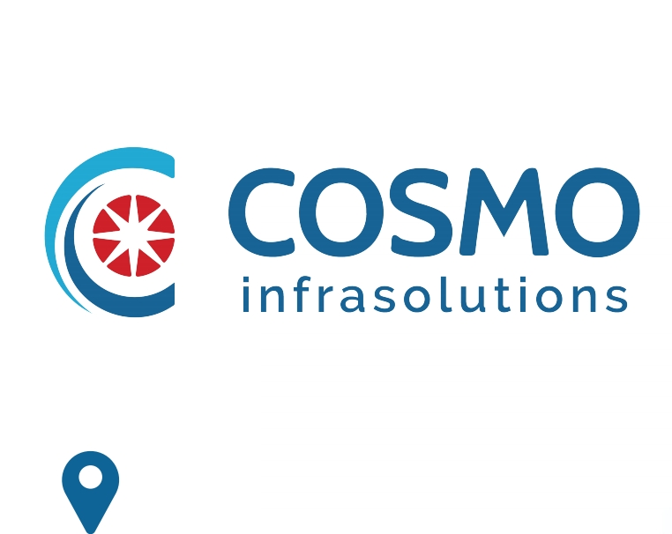



140, ShriGopal Nagar, Gopalpura Bye Pass Road,
Jaipur, Rajasthan 302015
+91 141 2500801
info@cosmoinfrasolutions.com
www.cosmoinfrasolutions.com

